Slide 1
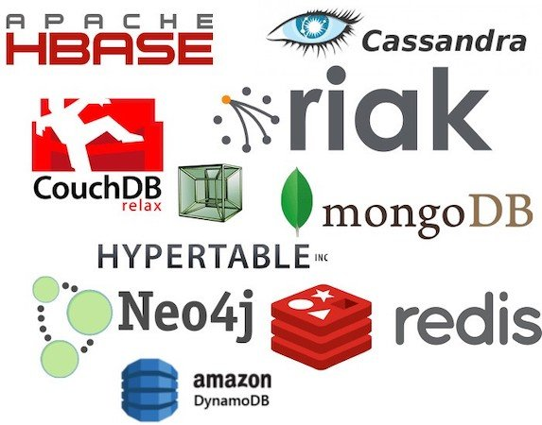
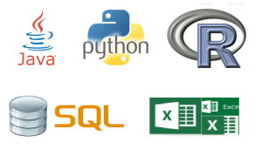
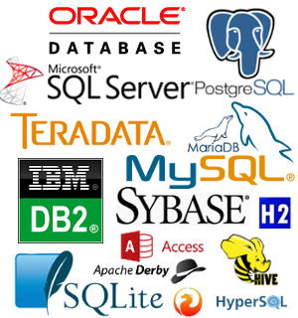
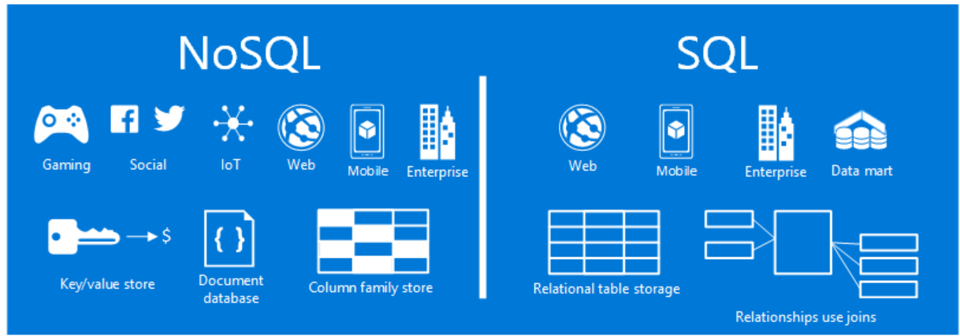
Data Industry Standard Tools
By Maz

Slide 2
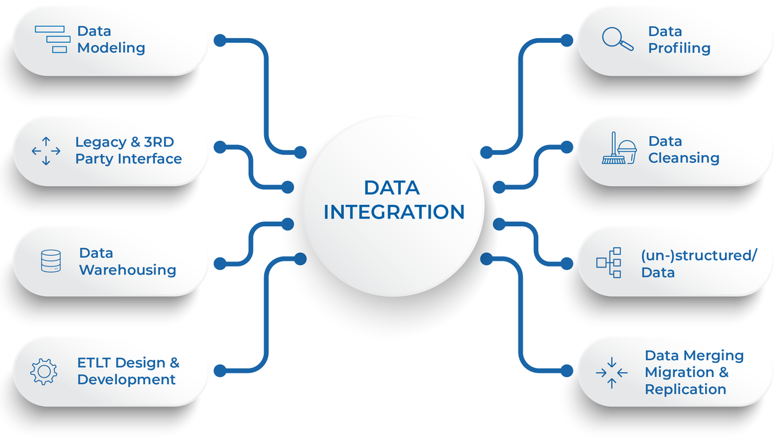
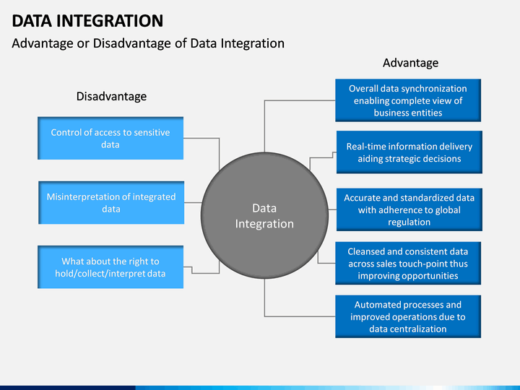
Intro
Data integration is the process of combining data from different sources into a single, unified view. Integration commences with the ingestion process, which includes steps such as cleansing, ETL (Extract, Transfer and Load) mapping, and transformation.

Slide 3
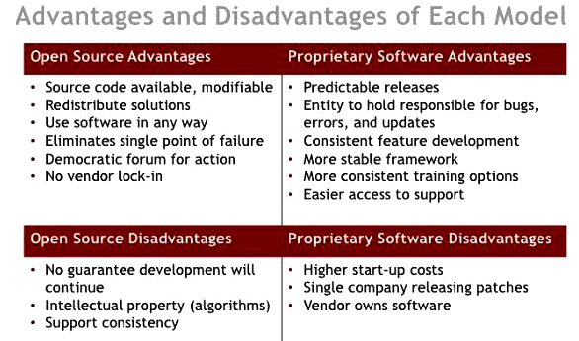
Data Integration tools software
Data Integration tools are software used to execute the Data Integration process, where you move data from the source to the destination. This includes performing mapping, transformation, along with data cleansing.
There are many tools used in data integration; these include proprietary software, which is known as closed-source software and non-proprietary software, also known as open-source software.

Slide 4
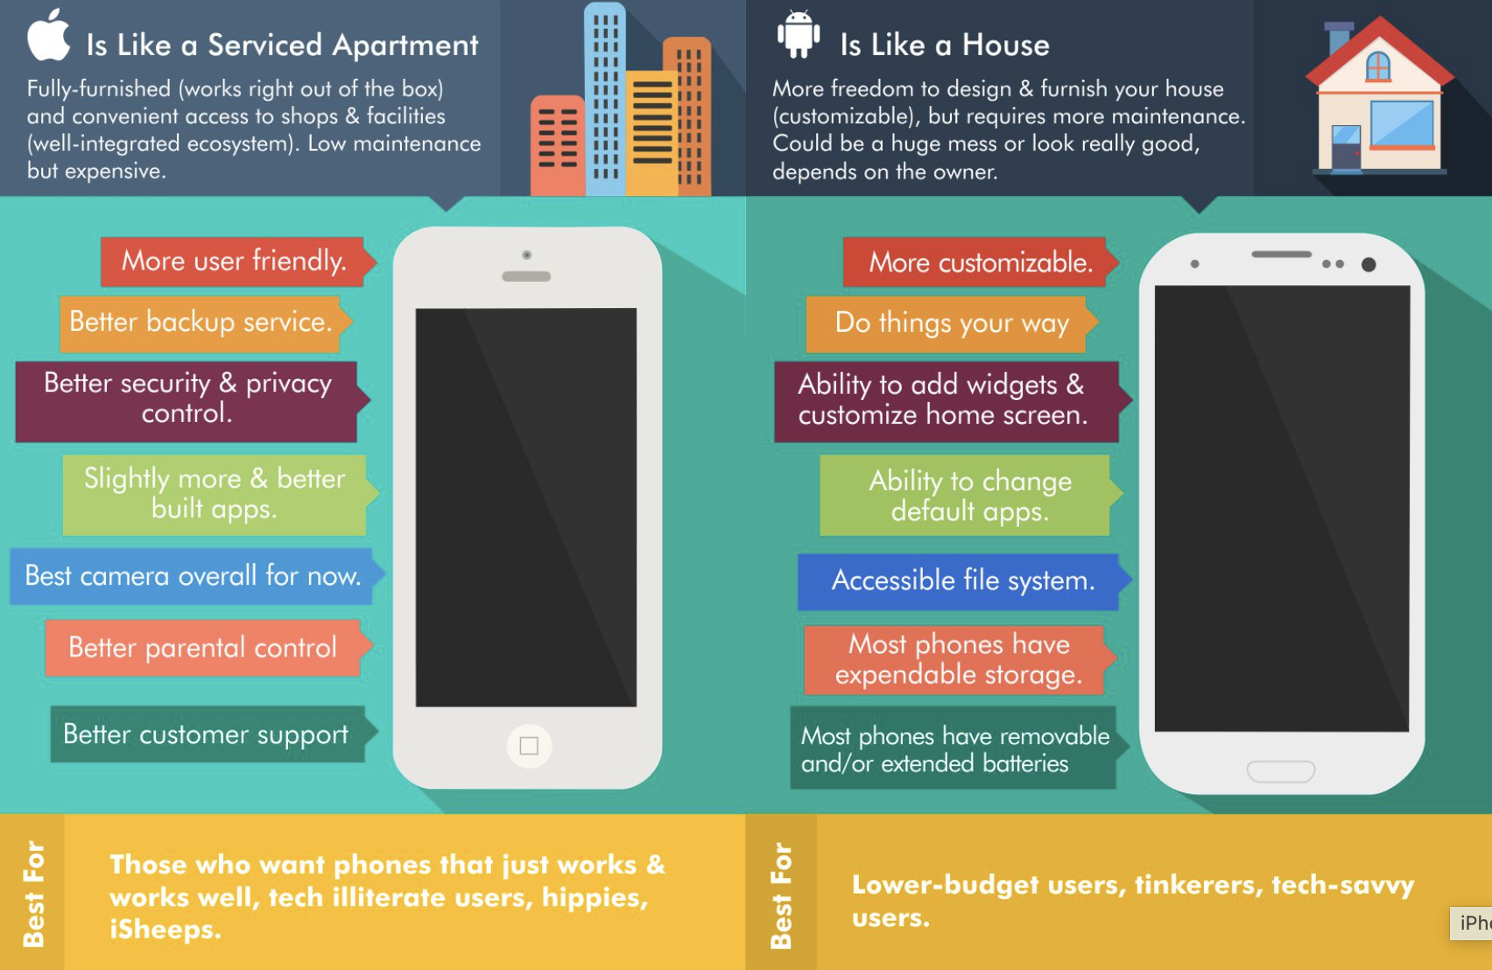
Open and closed source software example
An everyday common example might be: the operating software of Apple’s iPhones (iOS) being closed source, preventing legal modification or reverse engineering; whilst on the other hand, we could have Google’s Android operating software is open-source; so companies use like Samsung, Huawei, LG, HTC, Xiaomi, OnePlus, etc customise.

Slide 5
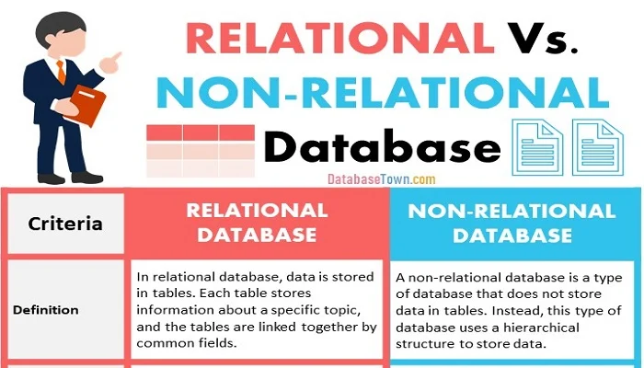
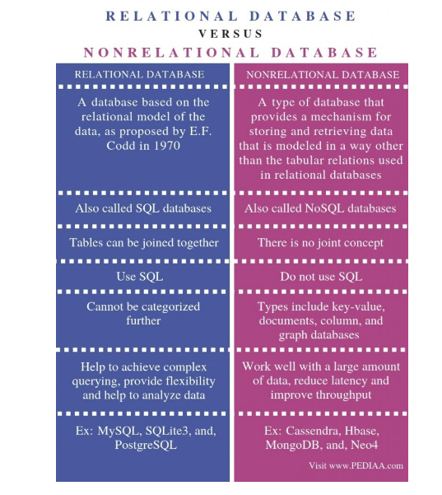
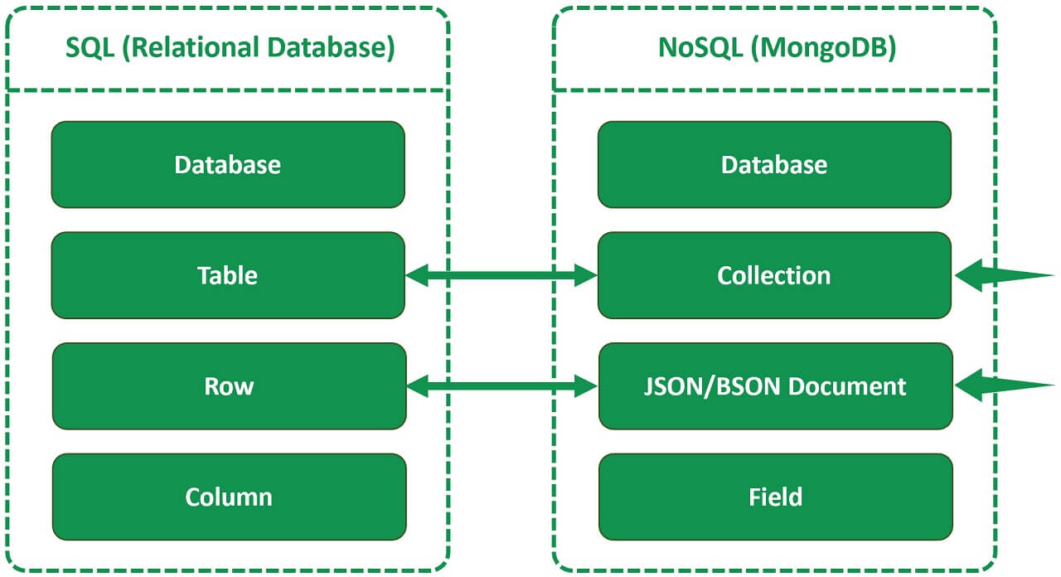
Relational and Non-Relational Databases
Relational databases (RMDBS) are structured while unlike Non-Relational Databases (NoSql) which are not

Slide 6
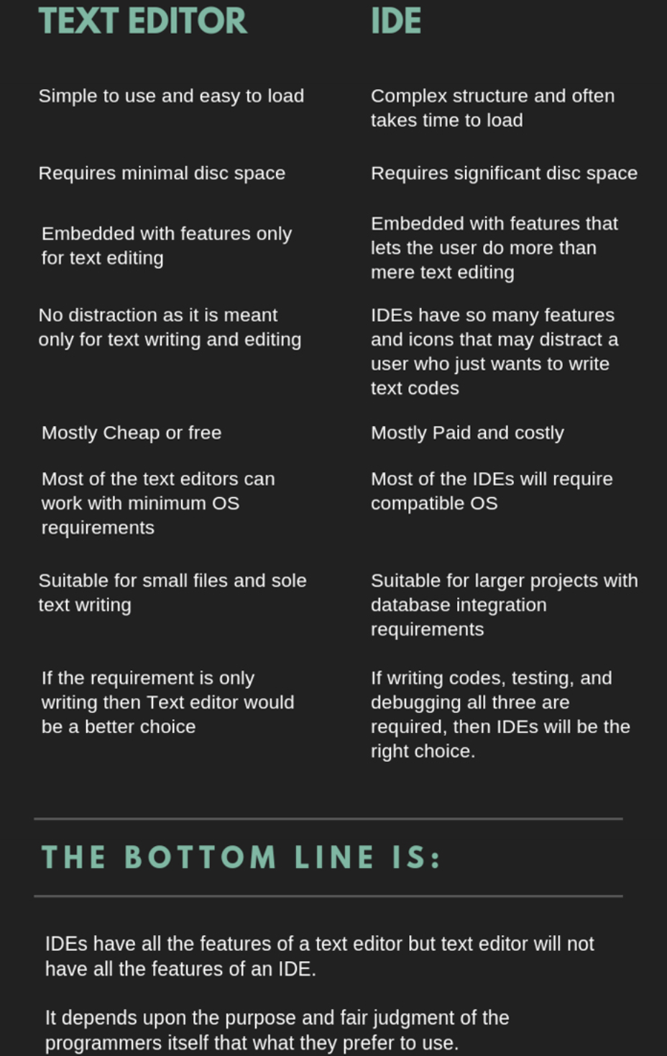
Writing programs
One of the most important skills for a data analyst is ability in a programming language.
These languages programmes can be written using text editors such as Notepad; however, programmers regularly use a text editor (Notepad) programmers often use a Software Development Environment (SDE), which includes a Integrated Development Environment (IDE); which features may include:
code editor used for writing and editing code
debugging functionality used to fix errors in a program before releasing it to the public
an interpreter takes single lines of code
and a compiler, which takes a program as a whole

Slide 7
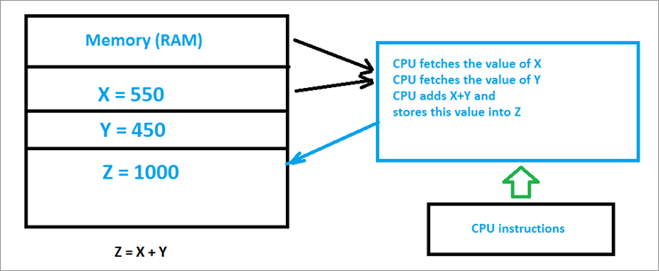
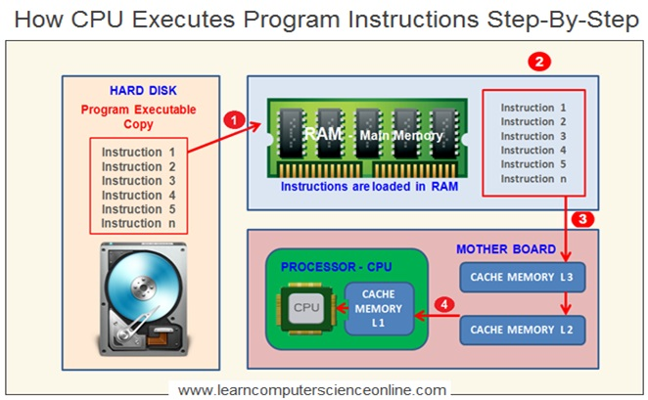
Writing programs(continued)
Writing lines of code is just like giving instructions

Slide 8
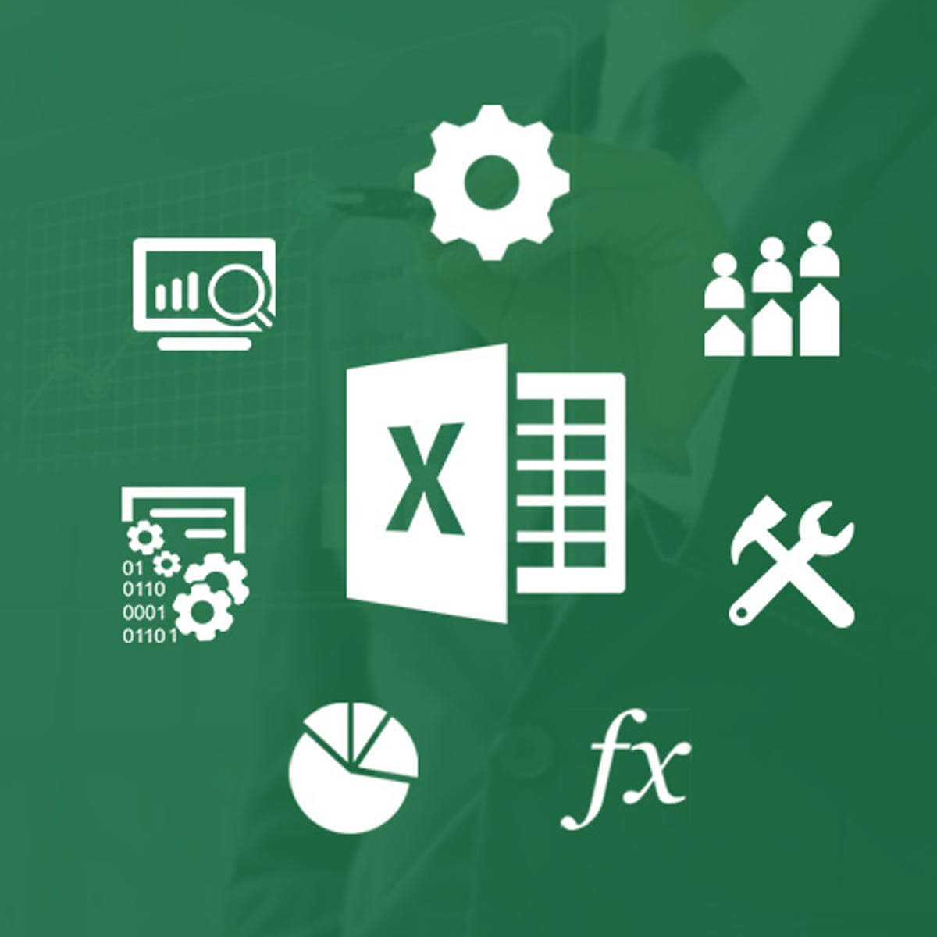
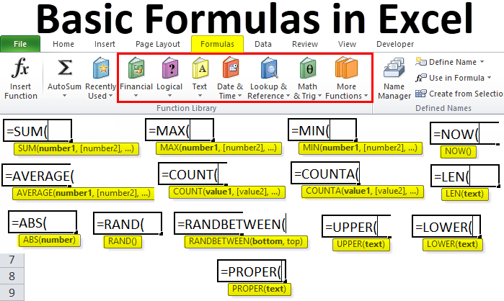
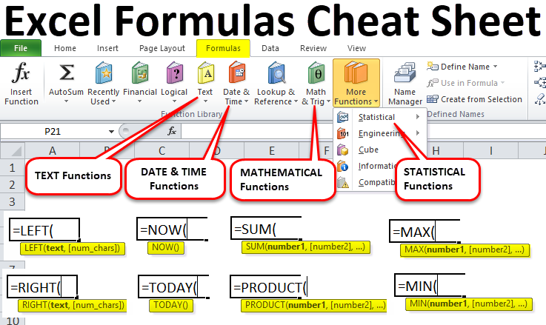
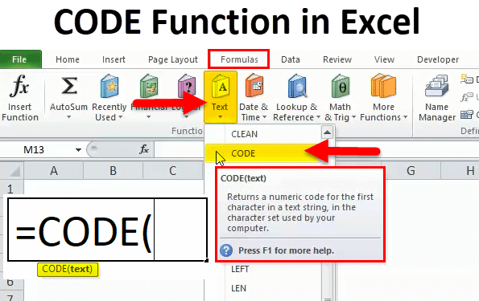
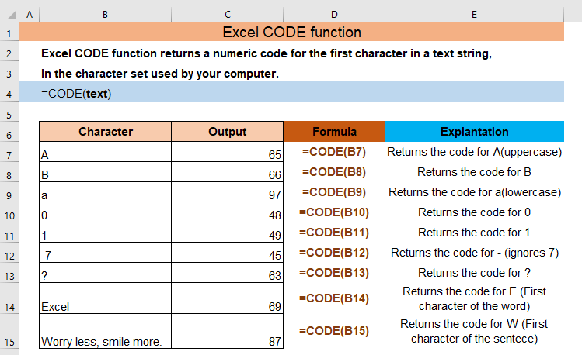
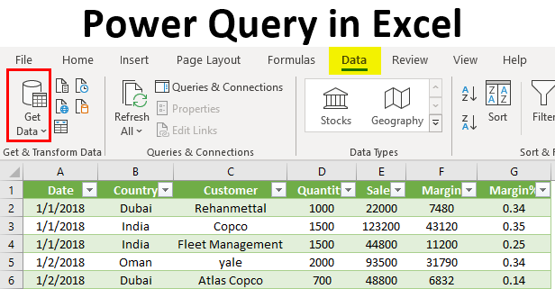
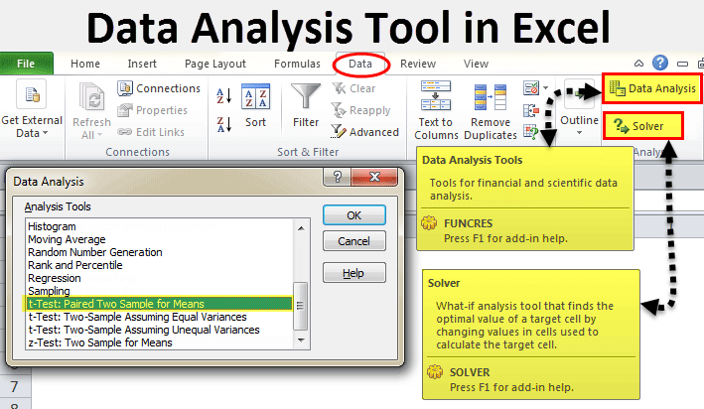
Commercial software like Microsoft Excel
Cost | Its cost is either almost for personal use, £150 for a single personal licence or £7 monthly subscription, along with a free version with limited functionality, however business and enterprise licences vary.
Speed | Speed by seamlessly linking data sources gives insights quicker: but struggles with unstructured and semi-structured data; unable to read data formats such as JSON, making the ETL process tedious because of manual workarounds.
Analysis & ETL function | ETL and analysis function is that Microsoft Excel lets your data in a spreadsheet get formatted, organised and calculated, making information easier to view by data analysts and other users, where boxes called cells are ordered in rows and columns; where you can clean your data with Excels “Auto Filter” if it seems out of place. Then its "Data" tab lets you "Remove Duplicates” and "Remove Empty Rows”. Get and Transform (previously known as Power Query) is its powerful embedded data analysis ETL pack for cleaning and sorting raw data, such as CSV, XI, XML and text files from various input sources. The “Power Pivot" tool lets you explore data to create pivot tables, pie charts and visualisations with power maps.
Alternatives | Google Sheets, Numbers, Apache OpenOffice, LibreOffice etc
Everyday use cases | Range from: Calculating, accounting, goal planning & tracking progress, inventory management, time management, data analysis

Slide 9
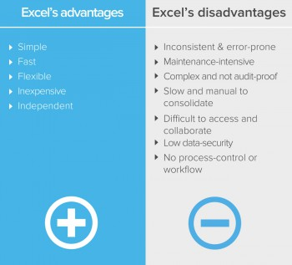
Excels limitations.
Excel, has its limitations and disadvantages; there can be issues with Excel where data can be corrupted or lost, were several copies by different people makes version control difficult, regardless of it being on a shared server, as people may overwrite others’ work as doesn’t reflect real-time.
Bottom line is commercial products such as excel are limited.

Slide 10
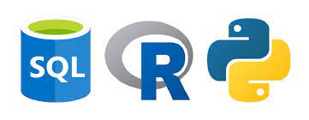
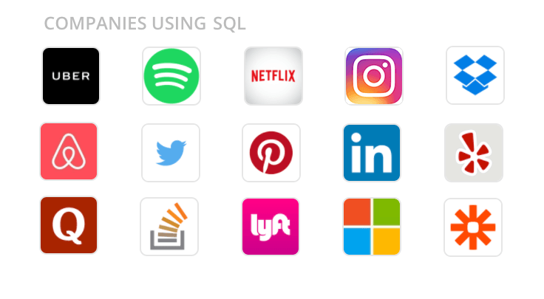
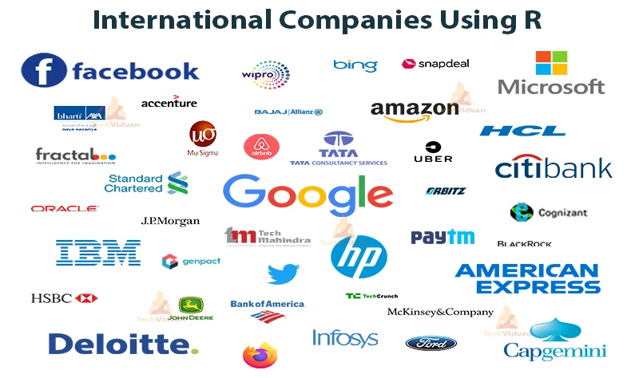
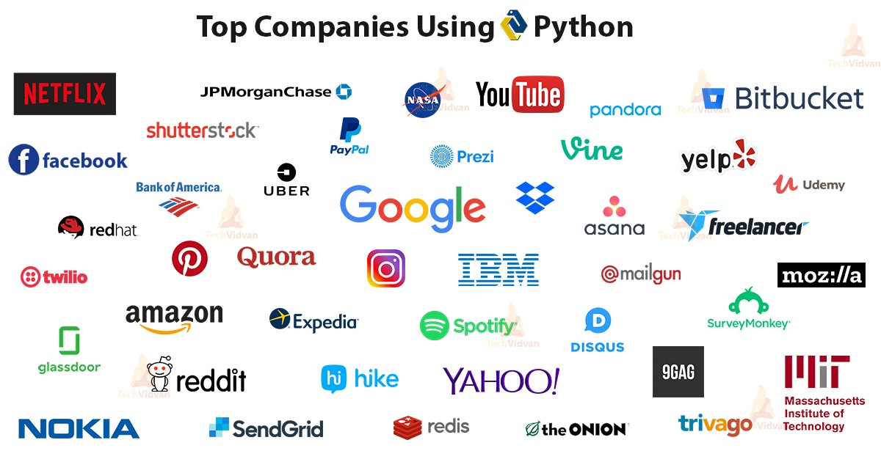
SQL, Python and R
Data analysts use all-purpose such as SQL (Structured Query Language) to communicate with relational databases, but when it comes to cleaning, manipulating, analyzing, and visualizing data, then you would use a general purpose programming language like Python or a language for statistical computing such as R, however SQL is still more efficient. All are available for free as open source and are relational databases.

Slide 11
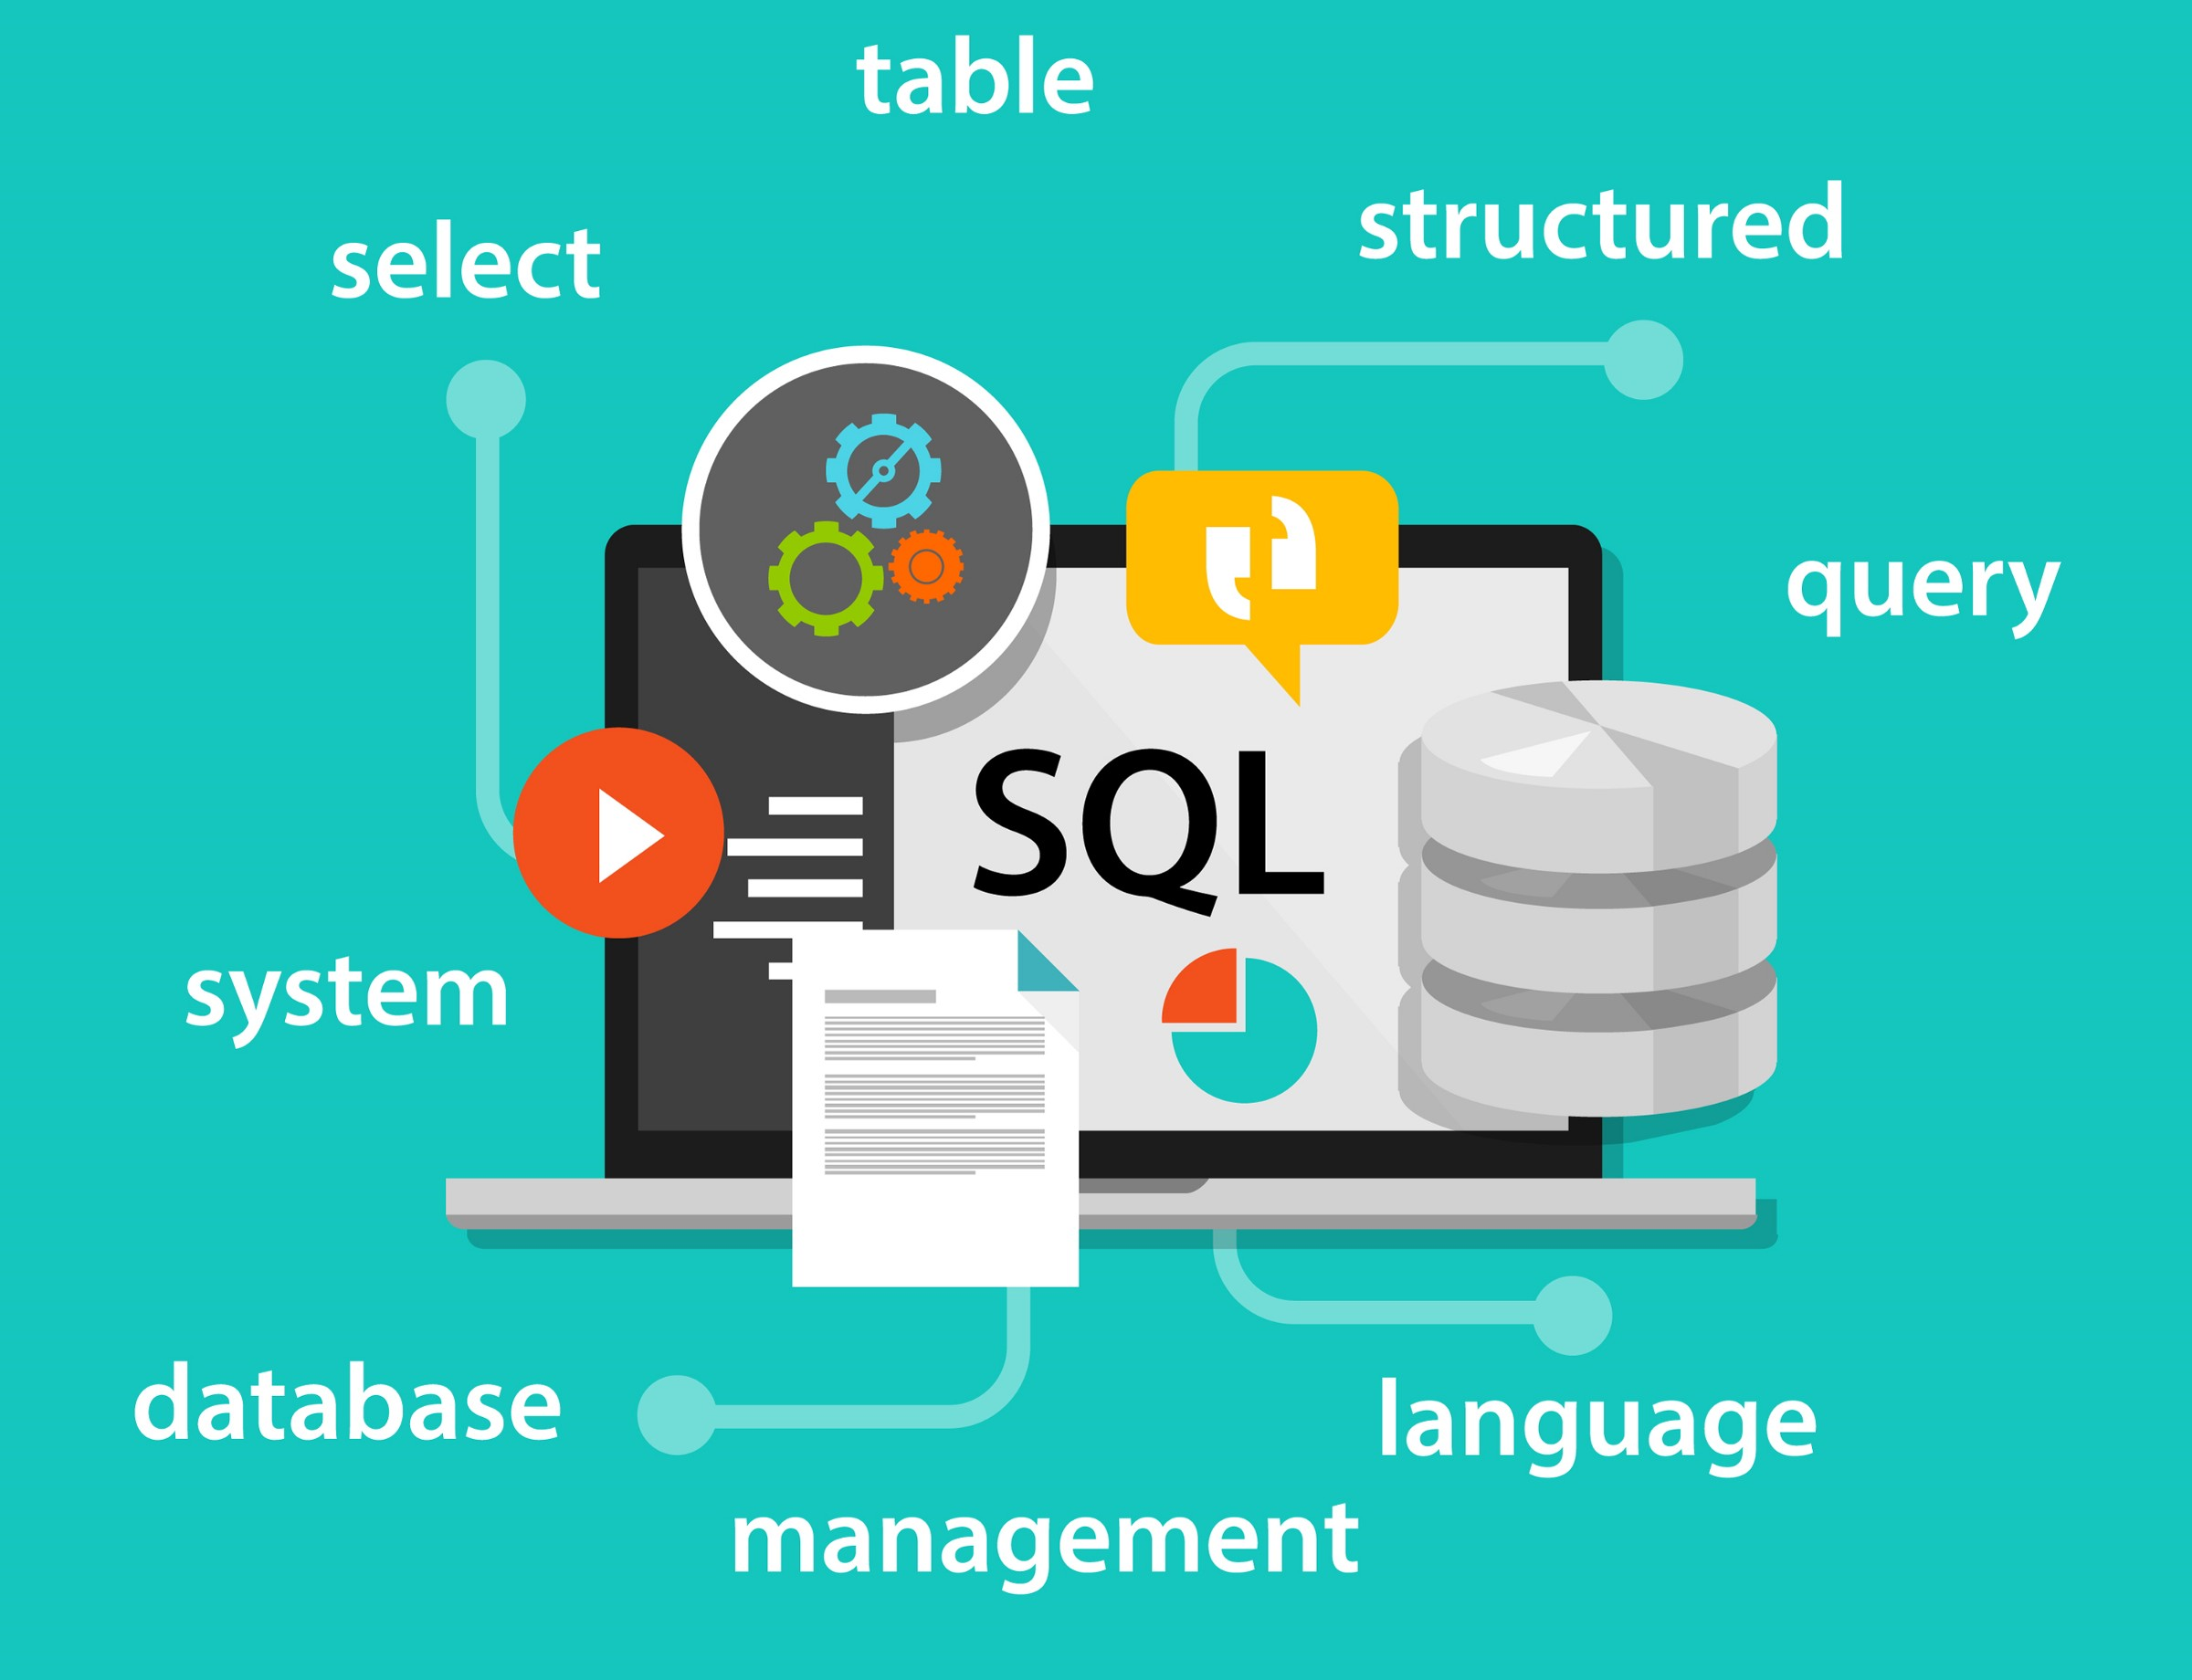
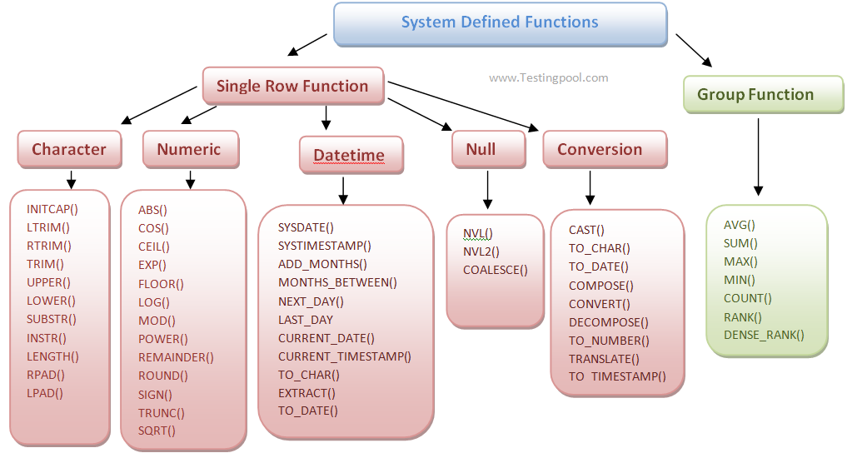
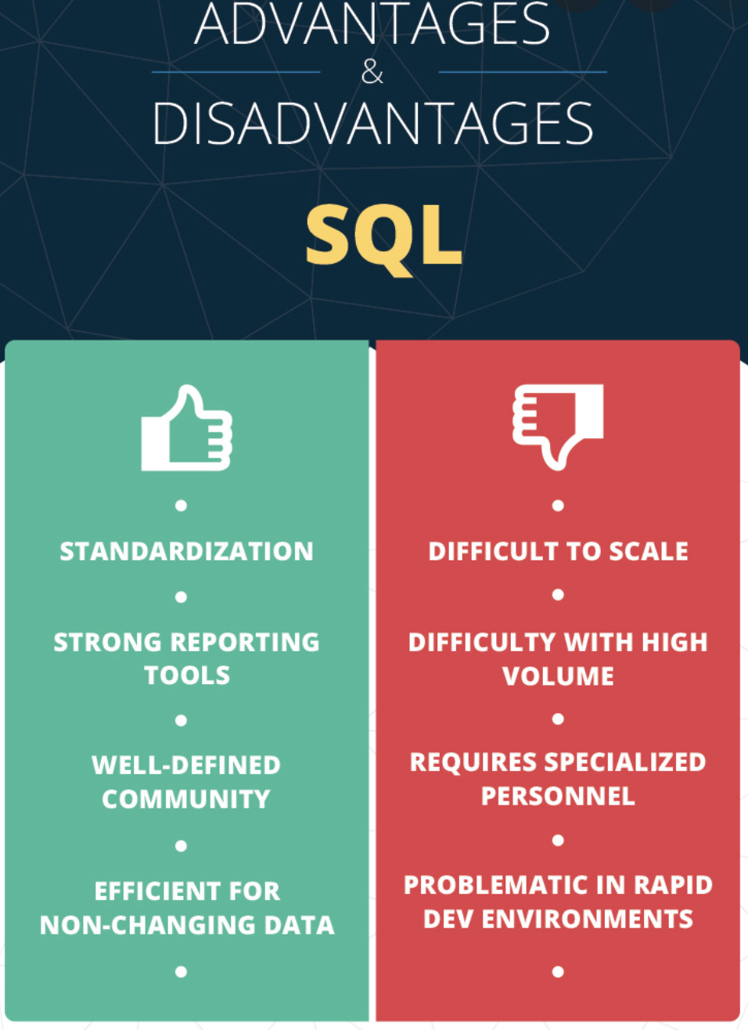
SQL
Cost | SQL Developer open source so is a free and SQL Developer is also included with any Oracle Database license, however is this cant be deployed in a commercial enterprise where a purchase and varies on the various vendors and packages.
Speed | SQL is much faster than Excel were some actions take mere minutes in SQL compared to nearly an hour in Excel, with performance is stable at 750 to 1300 microseconds
Analysis & ETL function | SQL (Structured Query Language) functions are sub-programs used in SQL database applications for processing or manipulating data and in 1986 to get first standardized by the American National Standards Institute (ANSI). SQL is a powerful tool as can create and manage large databases on many platforms, such as servers, computers, or tablets It is a non-procedural language (where the user has to suggest only “what to do” and not “how to do”) It helps communicate with databases in an easy-to-use English statement of a DML (data manipulation language) and DDL (data definition language) tools to support the creation and maintenance of databases it can retrieve data from a relational database or manipulate data by adding ( INSERT ), changing ( UPDATE ) and removing ( DELETE ). In the first phase of ETL process with extraction in the involving metric sources, database management systems and even simple spreadsheets for storage means , its commands can also facilitate fetching the data from various tables and even separate databases.
Alternatives | Teradata Vantage, MySQL, Oracle Database, IBM Db2, Amazon Relational Database Service (RDS), PostgreSQL, SAP HANA Cloud, Toad For Oracle.
Everyday use cases | From company employee databases to inventory management in supermarkets information is derived by end-users from companies such as Instagram, Amazon, Netflix, LinkedIn, Flipkart, and Instagram, along with the likes of Uber utilising it for data and performance analysis.

Slide 12

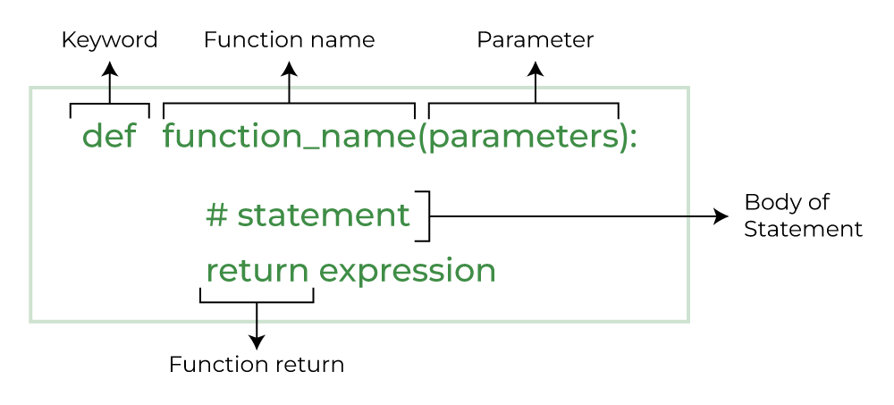
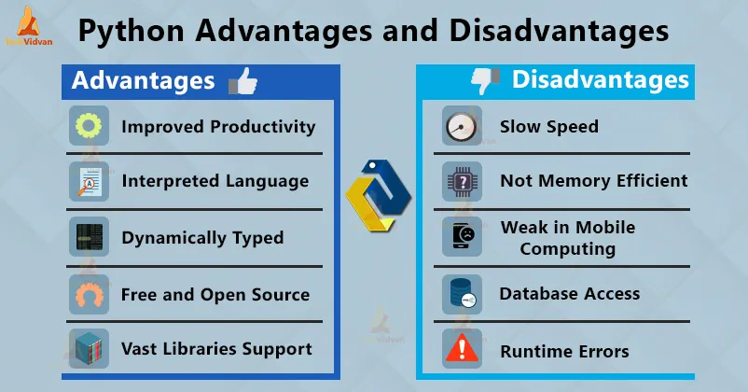
Python
Cost | Python is free and open source
Speed | Python is 5.8 times faster than R in some instances.
Analysis & ETL function | Python is a procedural language, so the program code is written as a procedure of step-by-step instructions in a sequence where the user has to specify “what to do” and “how to do”. Python enables integration with other programming languages and software development tools. Code written in blocks are functions to carry out a specified task. Python has user-defined functions and built-in pre-defined functions. ETL lets you activate the data transfer between systems and is an essential part of your Data stack processes. Python has a range of library support (e.g. Django for web development, etc.), along with many developer tools, such as Jupyter Notebooks (JN) and IDEs, like PyCharm. Pandas is a popular, widely used Python library for data science, along with NumPy in matplotlib. It also has various Python ETL(petl) tools: that act as frameworks, libraries, and software, which include; Apache Airflow describing relationships between tasks using directed acyclic graphs (DAG) to; Luigi, Pandas, Beautiful Soup, Odo, Bonobo, Petl, pygrametl to name a few.
Alternatives | NodeJS, Java, Scala, Rust, Ruby, Elixir, Golang, Kotlin PHP.
Everyday use cases | Python is used not only for tasks such as developing websites and software for task automation but also for data analysis/visualisation and machine learning. Data analysts use Python to describe and categorise data currently existing by exploratory data analysis, which can involve profiling the data, visualising results, and creating observations for further analysis.

Slide 13
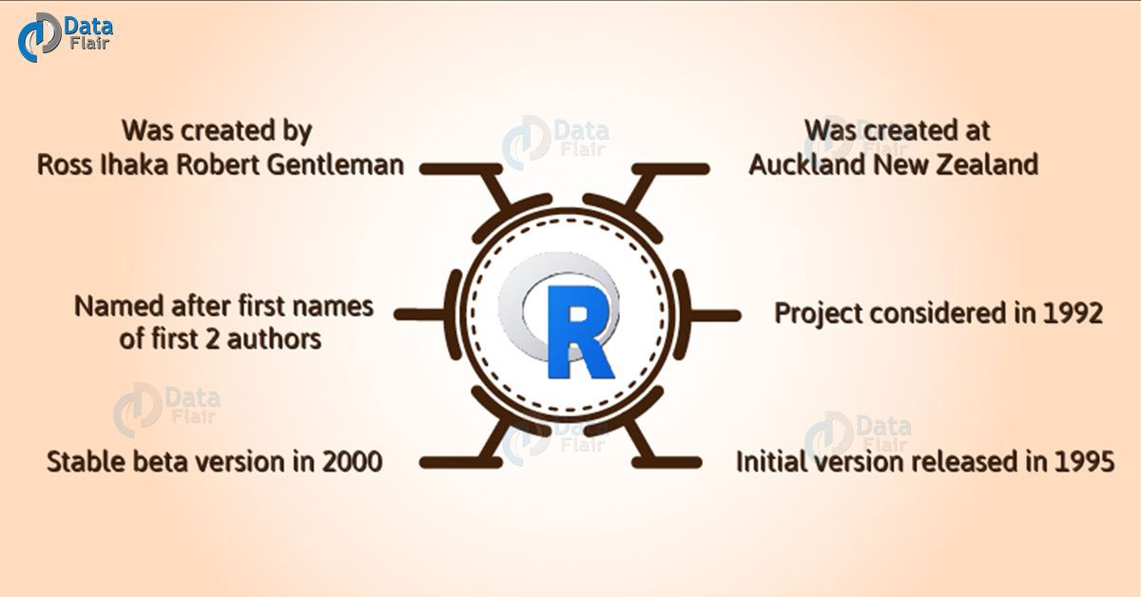
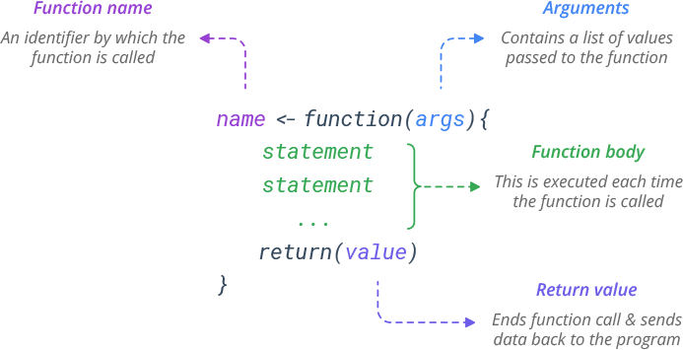
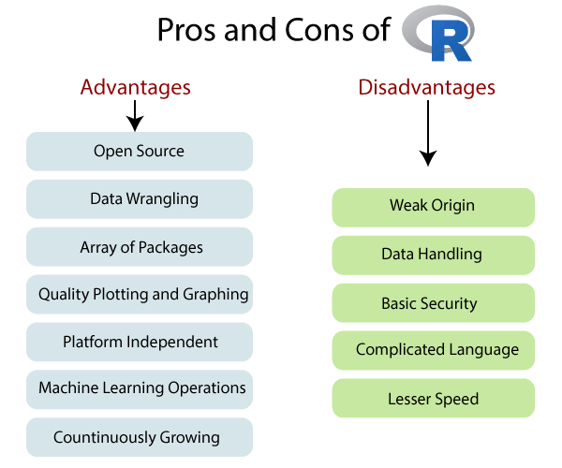
R
Cost | The official R software is open source and free, but RStudio Workbench Standard is $995 yearly for the first 20 users.
Speed | Longer code is required for even simple processes with R. Python is 5.8 times faster than R in some instances.
Analysis & ETL function | R is a procedural language, so the program code is written as a procedure of step-by-step instructions in a sequence where the user has to specify “what to do” and “how to do”. R has a built-in function to directly call in the program by users such as sq(), mean(), max() and user-defined function allowing you to write your own function. R has a lot of support for all sorts of sophisticated and obscure statistical libraries with packages that extend R’s base functionality, including tidyverse to transform, visualize and streamline your workflow; ggplot2, enhancing R’s visualization capabilities; and TensorFlow, extending R’s utility into machine learning. Rstudio for R is used for development. R can be run in Jupyter Notebooks (JN) with the right know-how. Although there are paid ETL tools for R, such as Panoply, Blendo and Stitch. There are also plenty of open-source R ETLs such as Apache Spark, Pentaho Kettle etc.
Alternatives | PythonPython is a general-purpose programming language; whilst RustRust is a systems programming language ; then MATLAB can analyse data and develop algorithms and create models; then you have GolangGo, SAS, RubyRuby, JuliaJulia and JavaJava.
Everyday use cases | R is a programming language made by statisticians for statistics mainly with data: were its widely used by; business analysts, data analysts, data scientists, and scientists; as a language. for statistical computing and data visualizations.

Slide 14
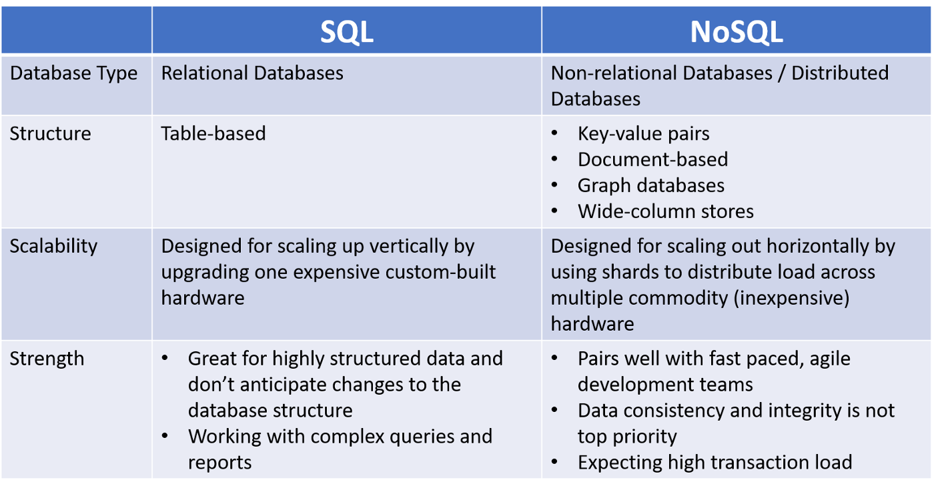
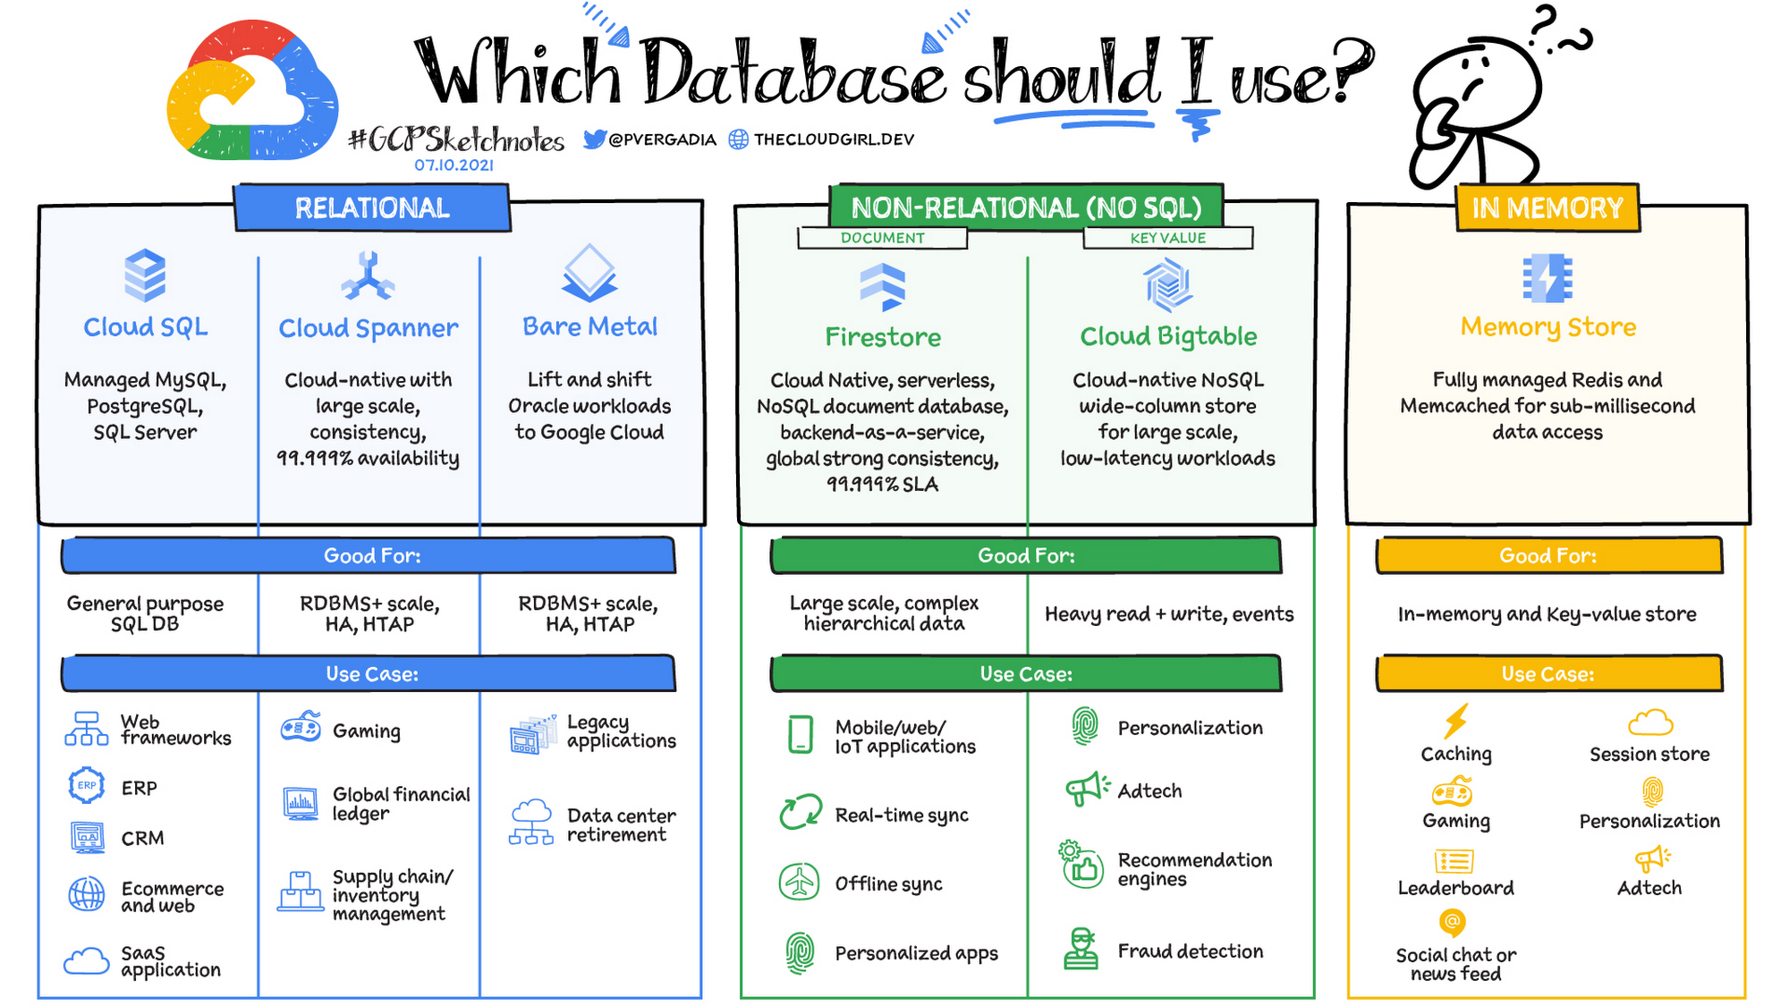
Relational and Non-Relational Databases(continued)
Relational databases have been successful for decades, giving persistence and concurrently controlling with a mechanism that integrates, but frustrations have been with app developers over relational databases due to impedance mismatch between the relational model and in-memory data structures.
NoSQL has been built for the 21st-century web estates since the late 90s dot com bubble, where there was a requirement to support large volumes of data by running on clusters which relational databases are not designed for, giving rise to Polyglot Persistence, of not being the same old square by following like sheep.

Slide 15
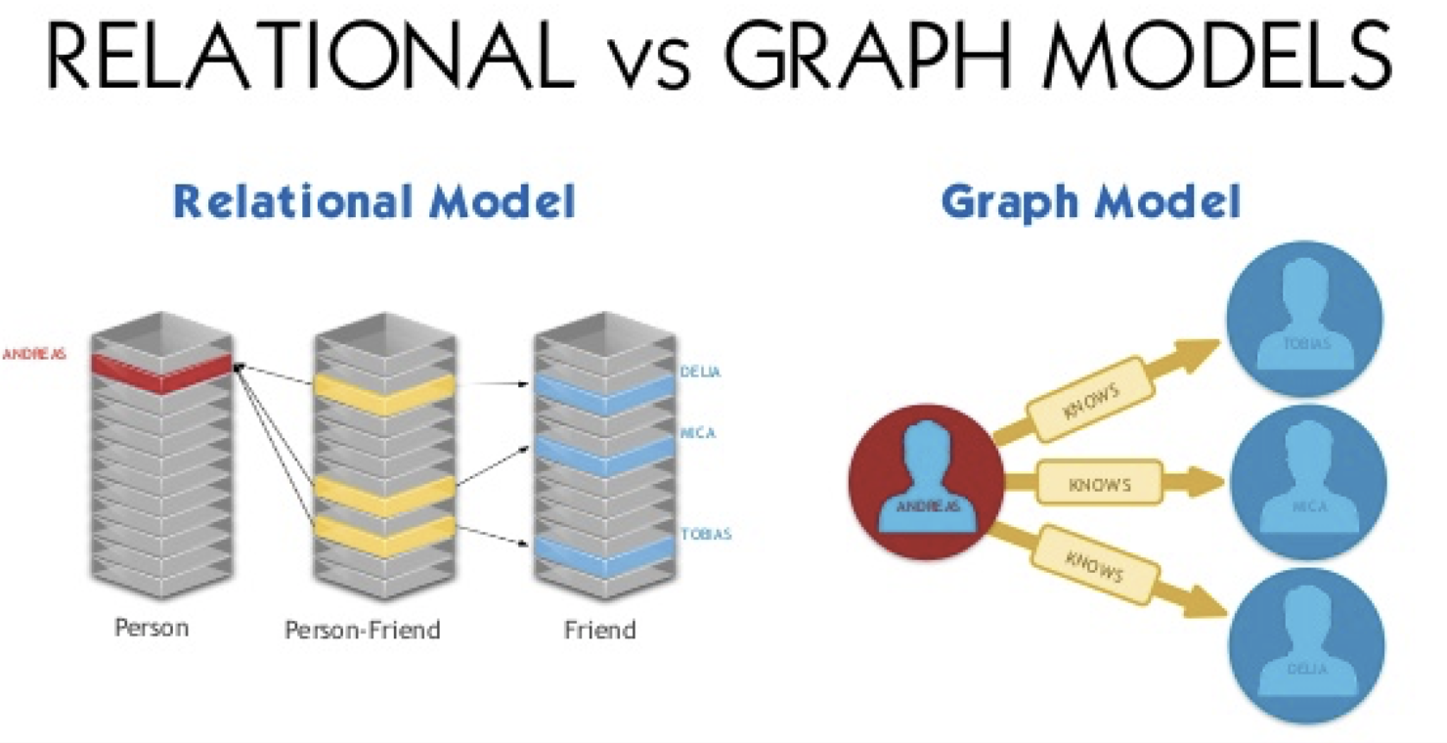
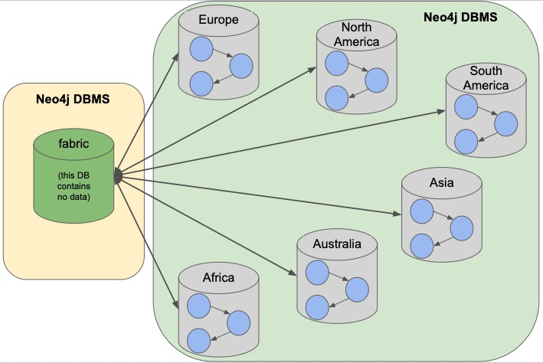
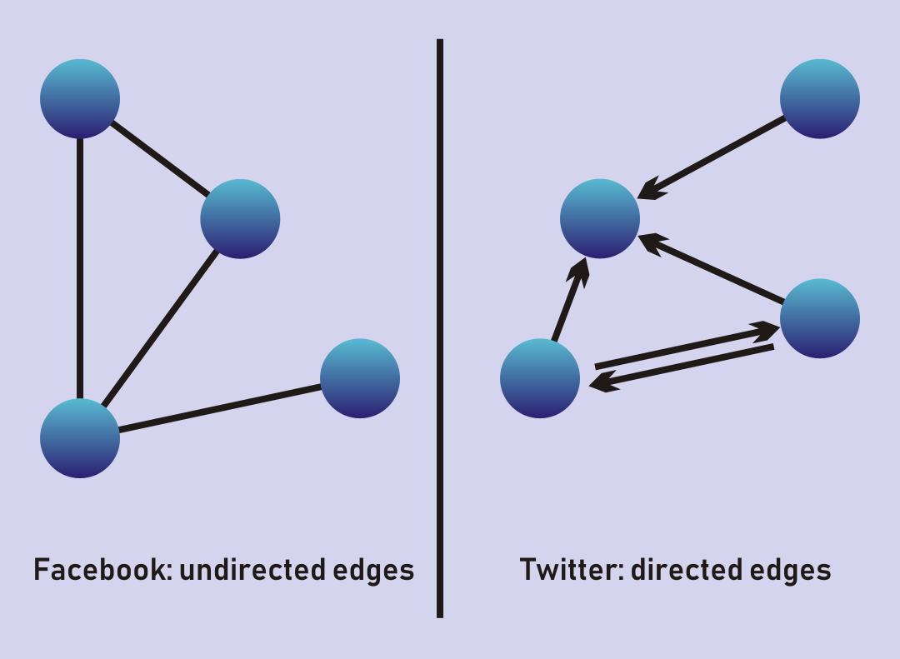
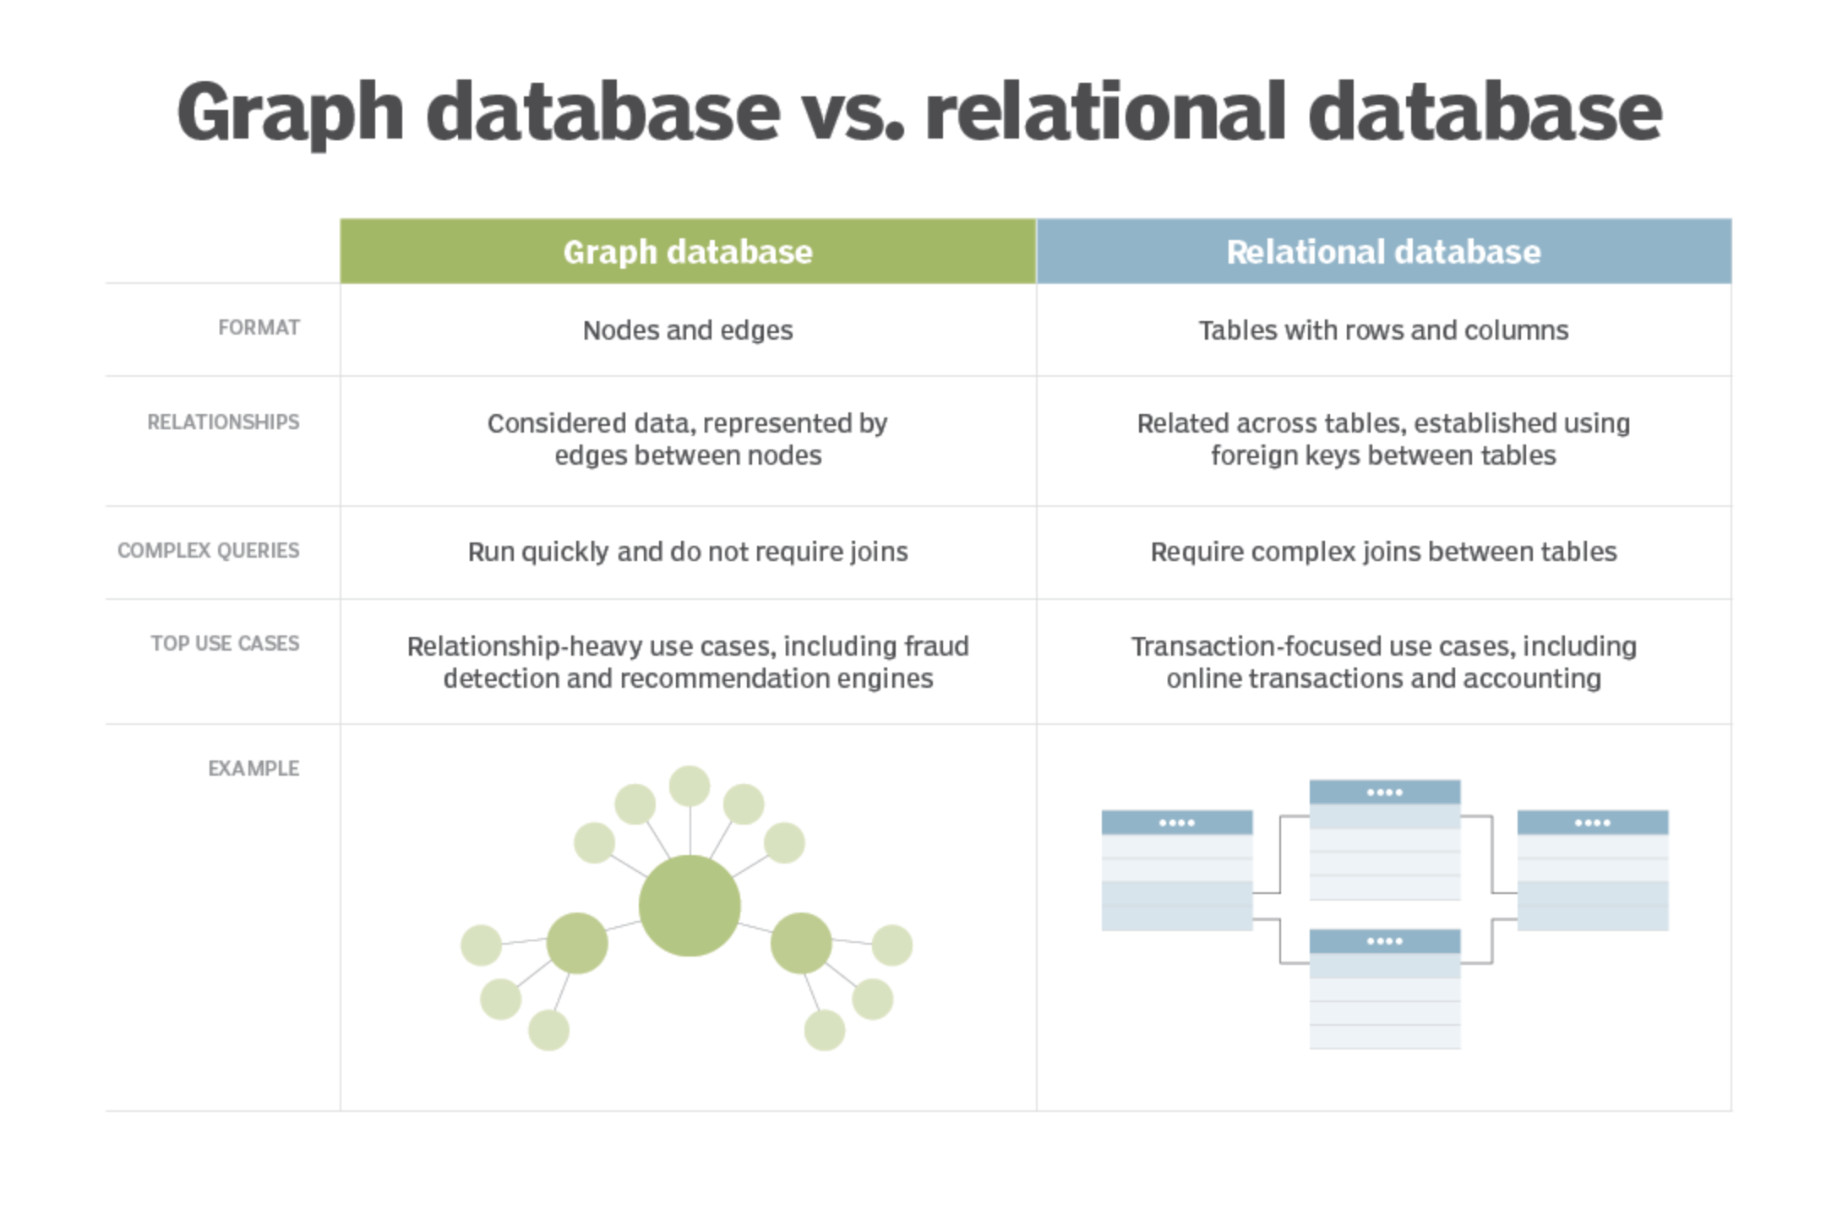
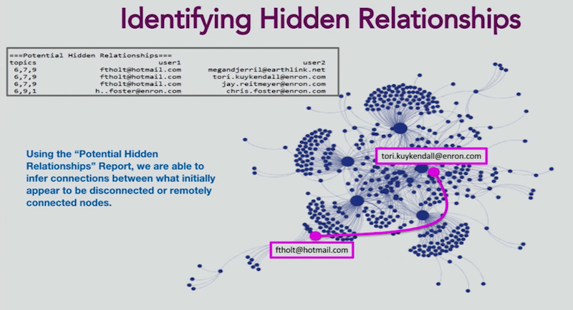
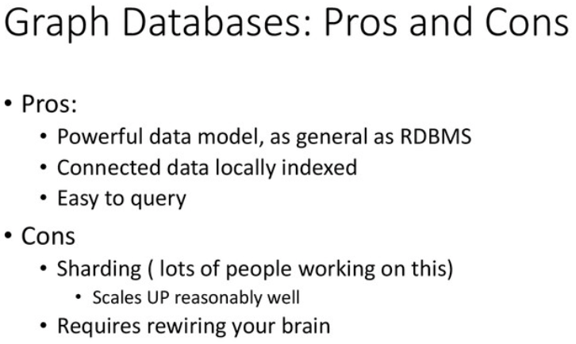
Graph Databases
Cost | GraphDB-Free and Neo4j Community Edition is open source
Speed | Navigating the edges, joins, dots or relationships are fast as the connections between nodes are being persisted in the database and not calculated at query times.
Analysis & ETL function | The concept of a Graph Database was introduced in the year 2000 around about the dot com bubble which was also around about the time online dating and social networking started and was based on the theory of graphs. A graph database concentrates on the links/relationships between data elements, were each element is stored directly as a node (for example a social media graph of a person) for first-class elements of the database instead of traditional databases. Just like every person and company can be seen as a entity, these are seen as nodes which have properties, that have edges. Graphs function enables more efficient analysis, at scale for users, applying to these models pattern recognition, classification, statistical analysis, along with machine learning,
Alternatives | Examples of Graph database software include were sharding is used with popular Neo4j, then you also have other software such as Polyglot and, ArangoDB, Amazon Neptune, DataStax, Dgraph, FlockDB, OrientDB, Titan.
Everyday use cases | May include rogue behaviour by bad actors in fraud, social networks and knowledge graphs.

Slide 16
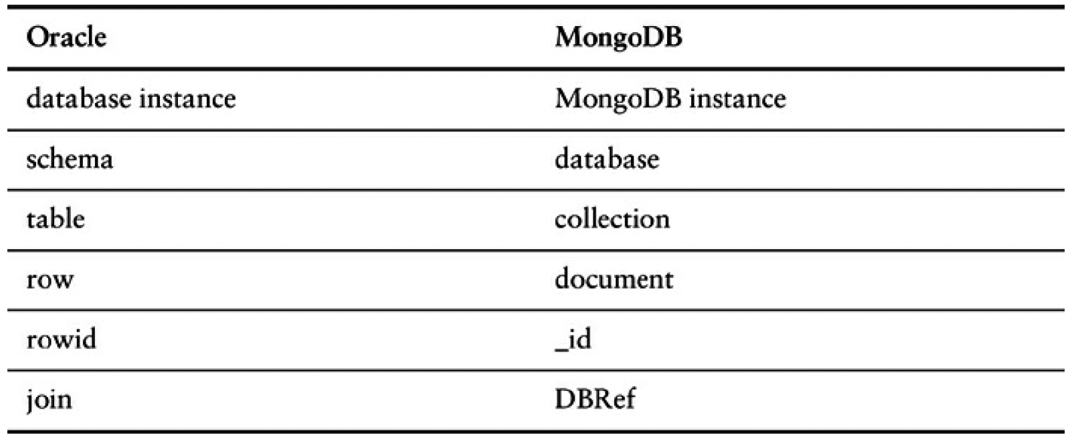
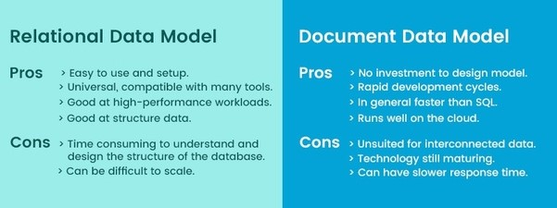
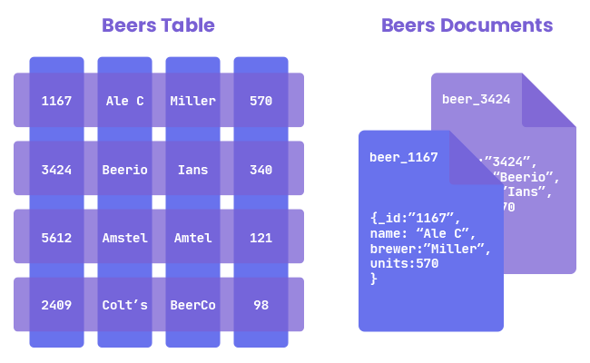
Document Database
Cost | There is open source software such as Apache Cassandra along with MongoDB and Neo4j are popular.
Speed | Document databases are fast and easy for developers to work with as they have an intuitive data model
Analysis & ETL function | Rather than storing data in fixed rows and columns, document databases use flexible documents, which are most popular alternative to relational and tabular databases, to store and query data as documents like JSON, BSON, XML etc, making it easier for developers to store and query data in a database by using the same document-model format as their application code. Below is an example of how terminology may differ in Oracle and MongoDB, pros and cons, along with an example. Document-oriented databases were inspired by Lotus Notes Storage Facility but now include software such as; DynamoDB and CosmosDB, Oracle, Terrastore,, CouchDB, and MongoDB; which is one of the most popular, that includes features such as full index support, replication and sharding along with everyday use cases such as trading platforms, E-commerce platforms, and mobile app development.
Everyday use cases | Due to their flexible schema, document databases can collect and store any data type. So you can create incorporating new content types; such as content which is user-generated like comments, images and videos.

Slide 17
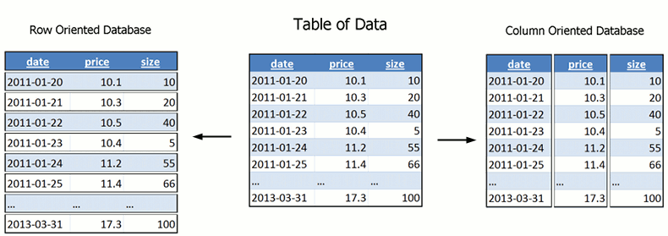
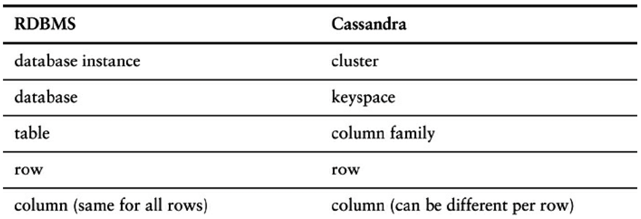
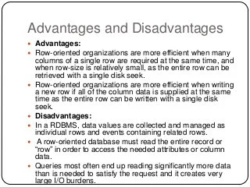
Column (or Wide Column) Database
Cost | Open-source software includes Google Cloud, Hbase, Snowflake, Amazon Redshift, MariaDB, Druid, Vertica and Rockset.
Speed | They have faster query times, maintaining speed and agility as they go straight to a field when detailed row information is needed.
Analysis & ETL function | A wide-column database is a NoSQL database that organizes data storage into flexible columns that can be spread across multiple servers or database nodes, using multi-dimensional mapping to reference data by column, row, and timestamp. Examples of column-based NoSQL databases include Amazon SimpleDB Cassandra, HBase, and Hypertable. Below is an example of how a normal RMDBS(Relational Data Base Management System) compares to a Column-Family Store on a system like Cassandra, which has a similar query language as SQL but is called CQL(Cassandra query language).
Everyday use cases | With the use of distributed clusters they are designed to scale out

Slide 18
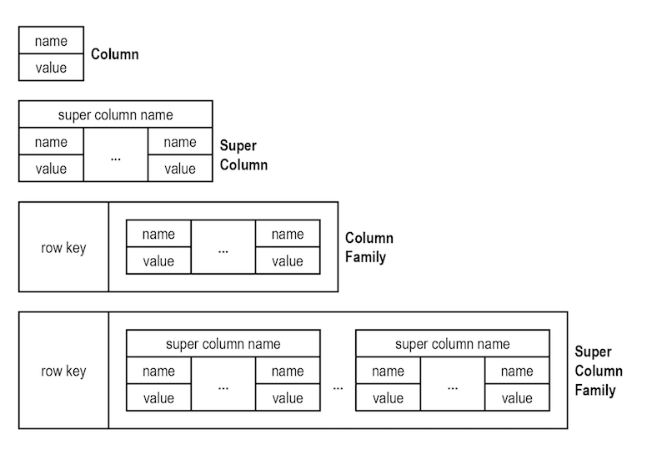
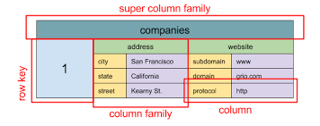
Column-Family Stores
Cost | Open source databases such as Apache Cassandra
Speed | As column families group columns as a table stored as a single key-value pair, reducing the keys stored in the key-value store resulting in an improved performance involving operations such as INSERT , UPDATE , and DELETE.
Analysis & ETL function | Permits storing data with keys mapped to values grouped into multiple-column families, which is ideal for event logging. Every family represents a map or cluster of data known as a standard column family, then when we have a column of these, its known as a super column, if we have a map of these, it is known as a super column family. Column orientated bases include MariaDB, CrateDB, ClickHouse, Greenplum Database, Apache Hbase, Apache Kudu, Apache Parquet, Hypertable, MonetDB
Everyday use cases | Applications that require: the ability to be always writable to the database, are geo-located over multiple data centres; tolerating inconsistency short-term duplicates and applications with dynamic fields.They are very scalable suited for massively parallel processing (MPP), which could mean data spread over a cluster of thousands of machines, as its fast to load and query.

Slide 19




Key value store
Cost | Open source software includes Aerospike CE, LevelDB, Apache Accumulo, BerkeleyDB, Apache Cassandra, HyperDex, Redis, Scalaris and Project Voldemort which is used by linkedin.
Speed | Key-value stores for in-memory data caching; to speed up applications by minimising reads and writes to slower disk-based systems, such as Hazelcast.
Analysis & ETL function | The key-value database is a NoSQL database using a simple key-value way of storing data. The key-value database stores data for a collection of key-value pairs where a key acts as a unique identifier. A telephone directory where the key is the name of a person or business, with the value being the phone number. Another example of a key-value pair is stock trading data. ETL and data analysis software includes Amazon DynamoDB, Amazon ElastiCache, ScyllaDB, Redis, Couchbase etc.
Everyday use cases | Caching data from rmdbs to improve performance, storing personal data on specific users' configuration and information for mobile apps, tracking Web application transient attributes such as shopping trolleys, storing user data, storing large objects, such as images and audio files, managing each player's session in multiplayer online games on a large scale.

Slide 20




